Slide 1
Data-driven enterprise
… or, Becoming a Better Watchdog
Sarah Cohen Walter Cronkite School of Journalism

Slide 2
Why data?

Slide 3
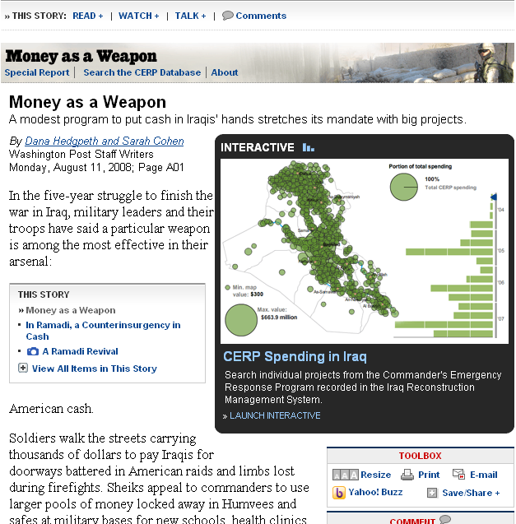
Because you want better questions for your sources

Slide 4
Because officials won’t engage or answer your calls

Slide 5
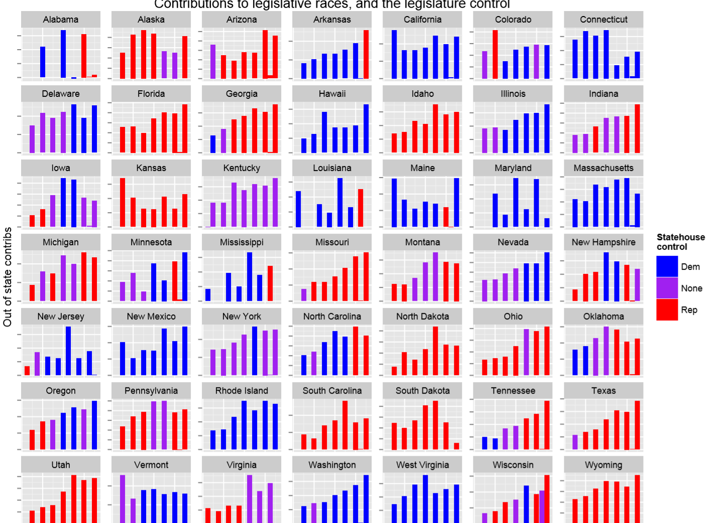
Because you want anecdotes AND evidence

Slide 6
Because records are contemporaneous and don’t forget

Slide 7
Because government is good at vacuuming information with no time to analyze it

Slide 8
Because no one else will count

Slide 9
Because it sometimes really isn’t a few bad apples

Slide 10
Because we want to report on what officials and institutions do, not what they say

Slide 11
Because, well, dogs

Slide 12
Where is data?
Hint: everywhere

Slide 14
“If it’s inspected, enforced or purchased… I want the data”
- Jennifer LaFleur

Slide 15
Take a tour

Slide 16
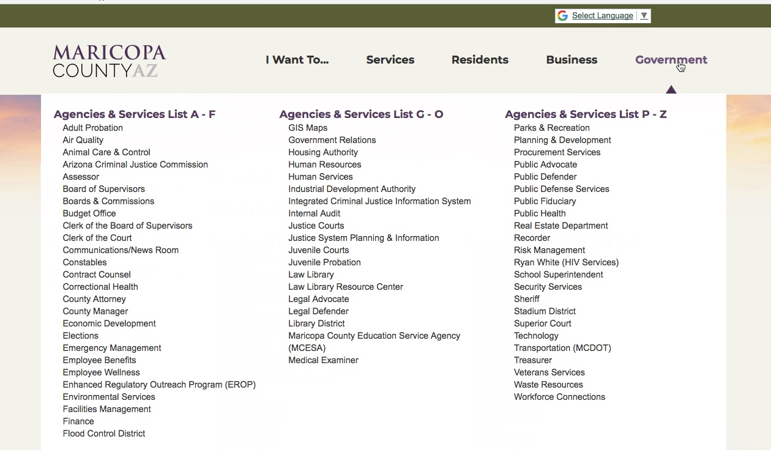
Or a virtual tour
??

Slide 17
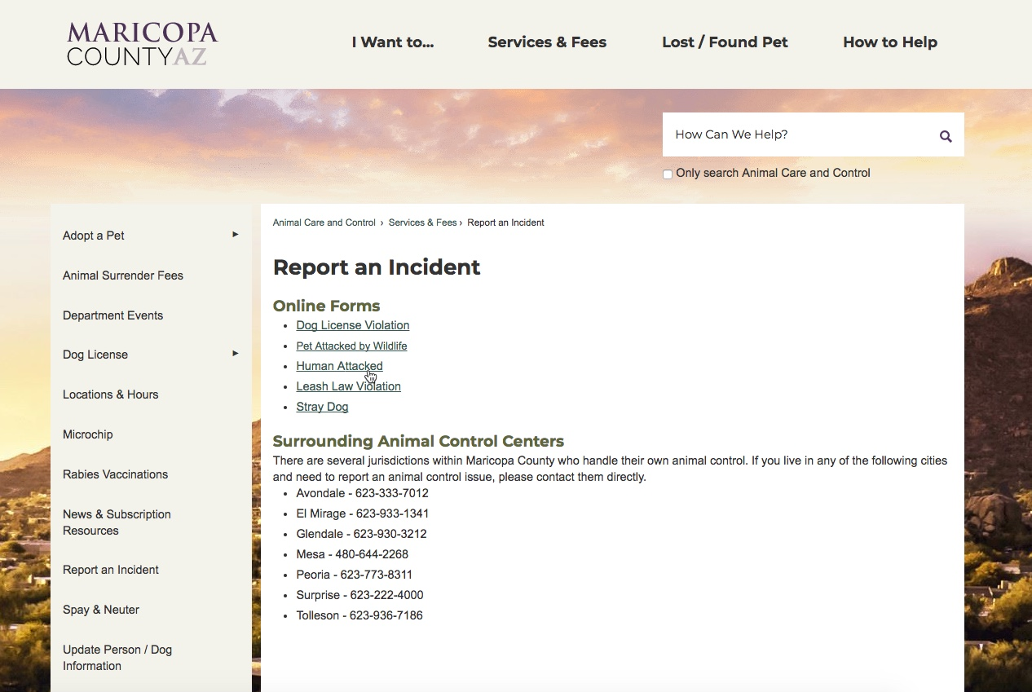
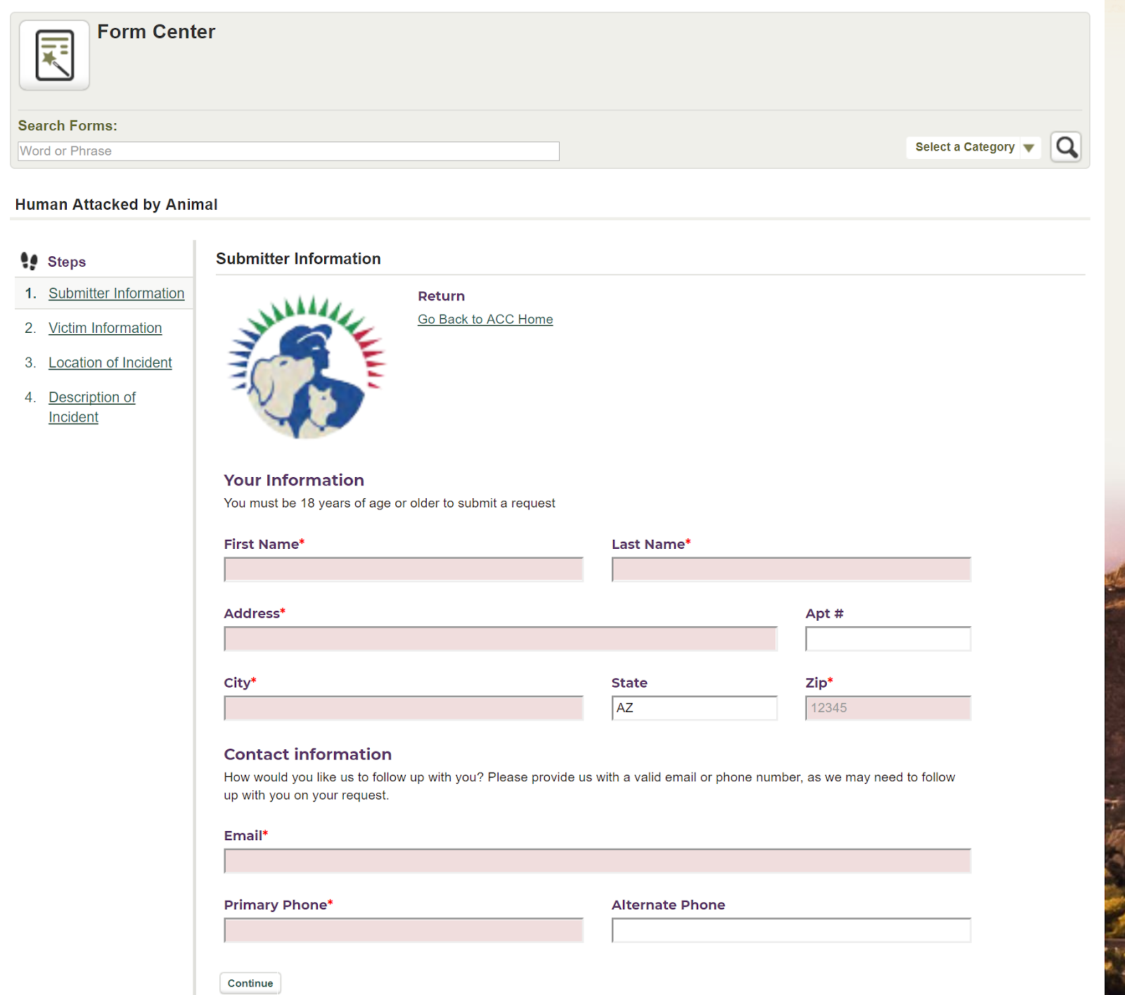
Follow breadcrumbs

Slide 18
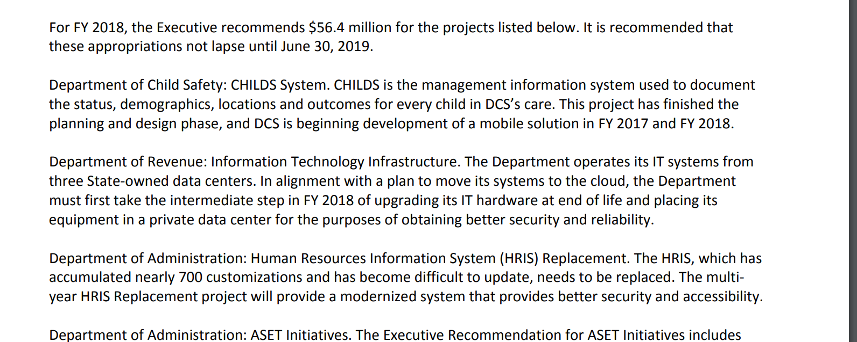
Names, not numbers, in budgets
IT initiatives
Officials
Offices and departments

Slide 19
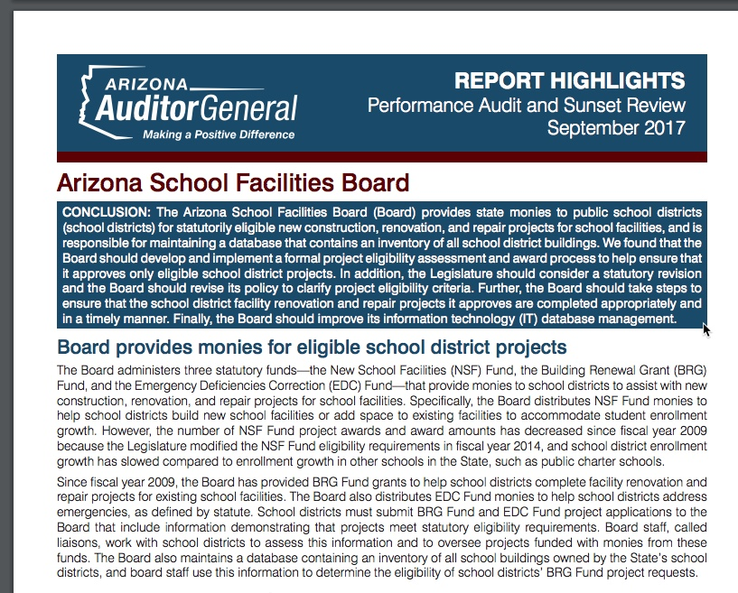
City, county and state audits

Slide 20
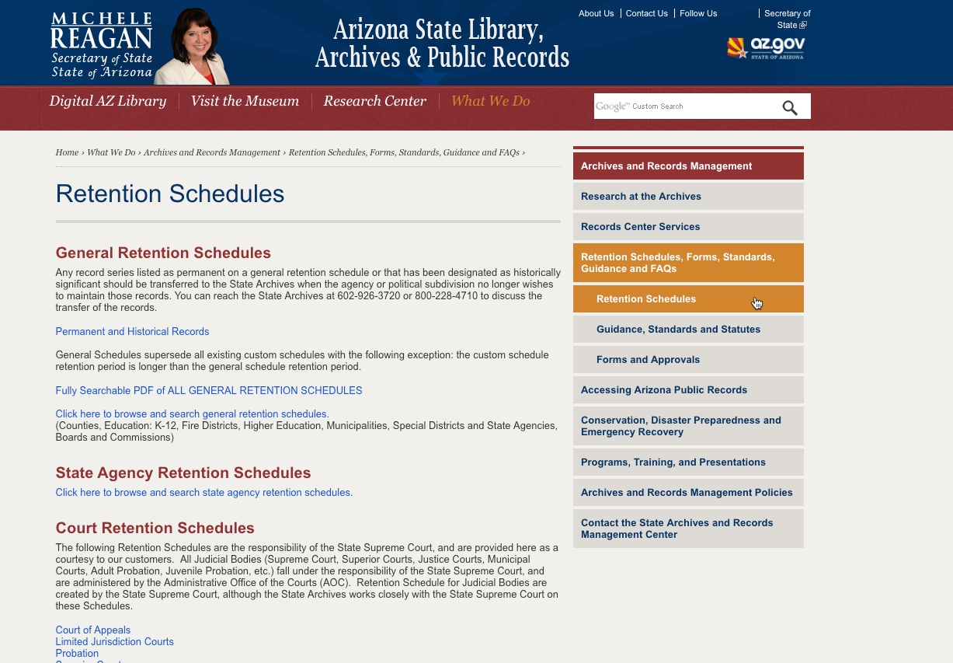
Records retention schedules

Slide 21
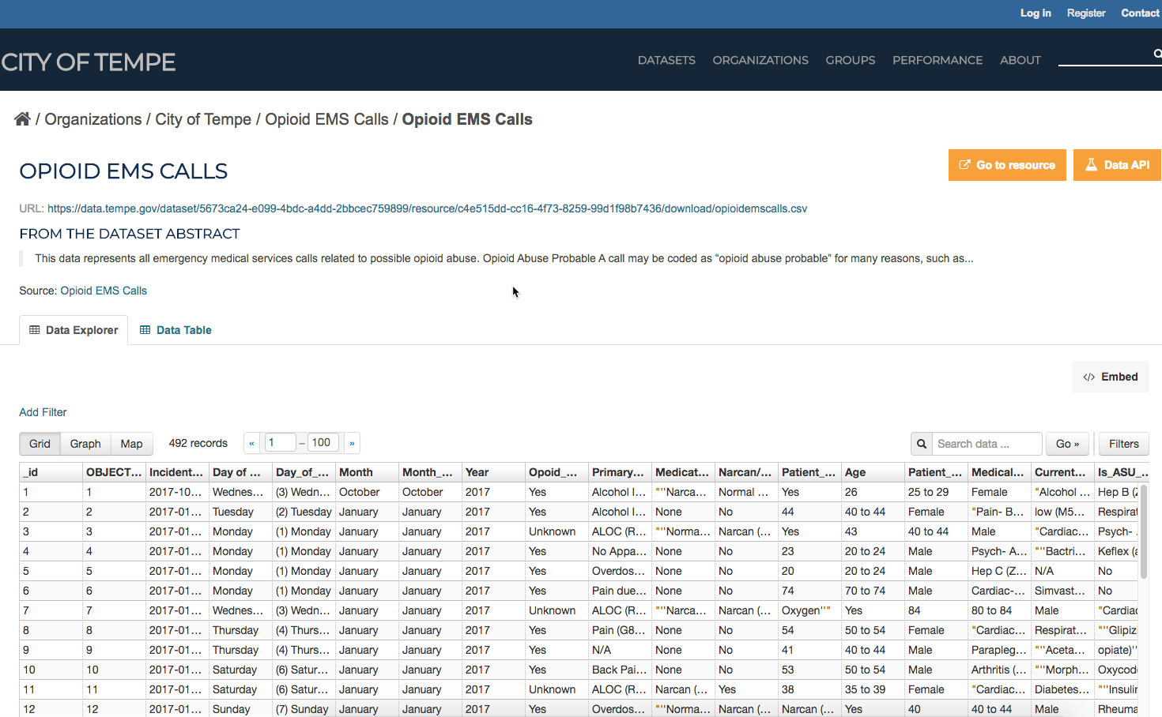
Look elsewhere

Slide 22
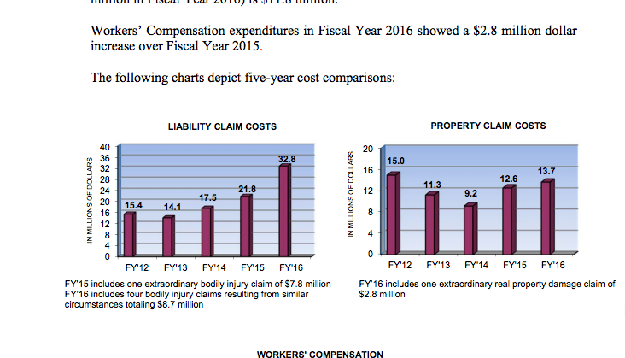
Work backwards

Slide 23
Common beat records *
Sports – Coaches’ salaries, player salaries,
Government – Inspections, disciplinary records, lawsuits and settlements…
Health care – Death records, ACA markets, Medicare / Medicaid spending…
Criminal justice – Jail bookings, crime incidents, court dockets…
Education – Performance measures, vaccinations, budgets, teacher rosters…
Business and economics – IRS 990, tax return data, Census…
Politics – Voter registrations, campaign finance, lobbying…
* THIS IS NOT A LIST

Slide 25
How to get started?

Slide 26
Envision success!!

Slide 27
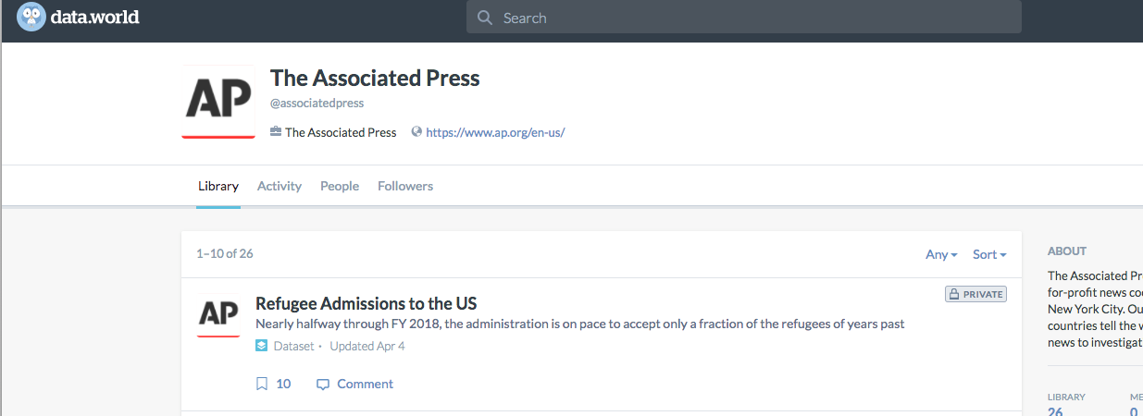
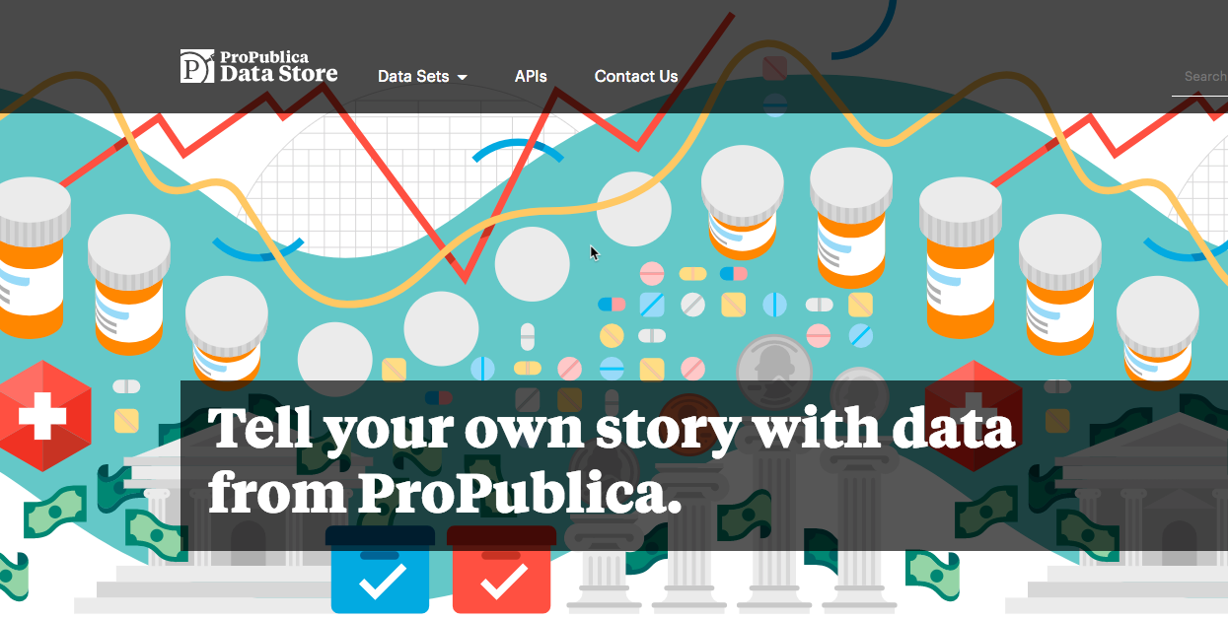
Easy data first

Slide 28
”Practice, practice, practice…”

Slide 29
Let’s go!

Slide 30
Thank you!
Sarah Cohen Knight Chair in Data Journalism Walter Cronkite School of Journalism / Arizona State University sarah.h.cohen@asu.edu / @sarahcnyt

