Slide 1
20 health stories in 60 minutes
Data stories you can do in your newsroom

Slide 2
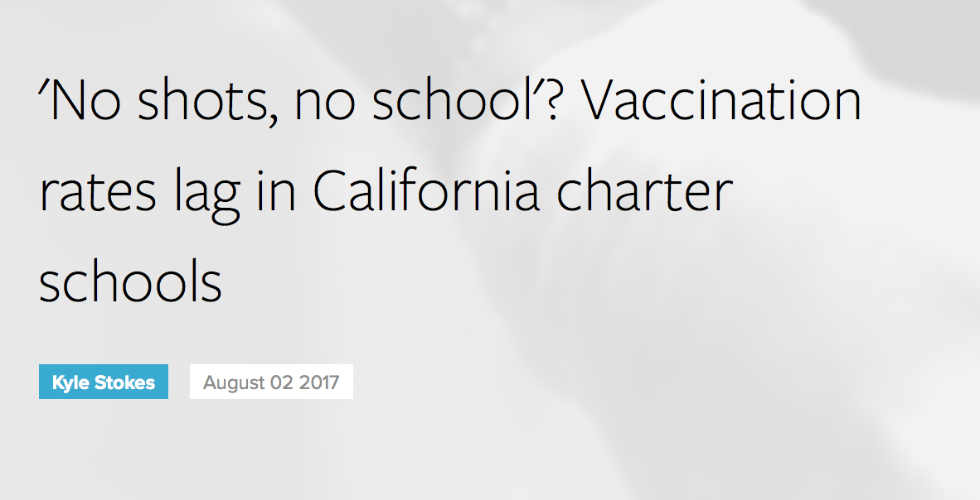
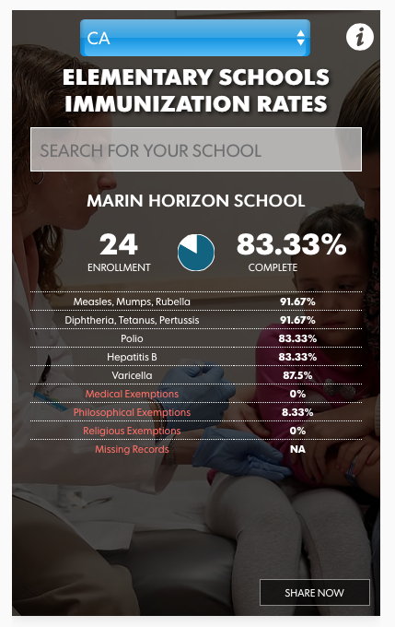
Vaccination rates/exemptions

Slide 3
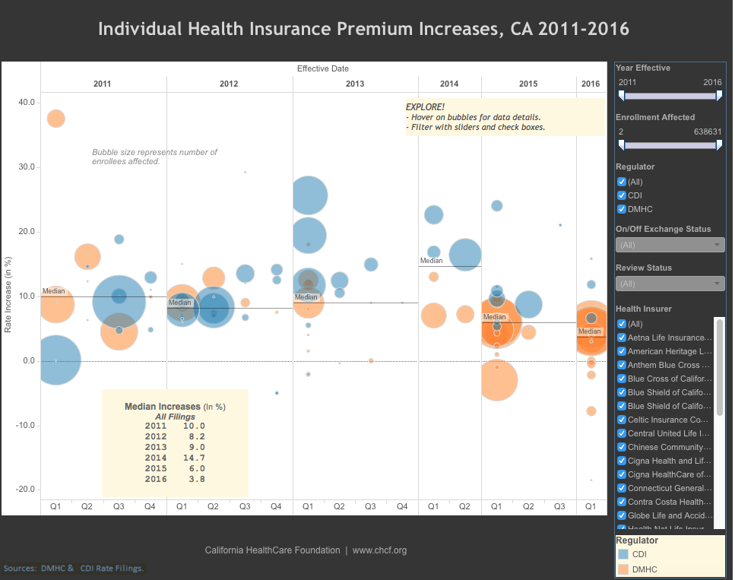
Insurance costs – rate regulation

Slide 4
How people die

Slide 5
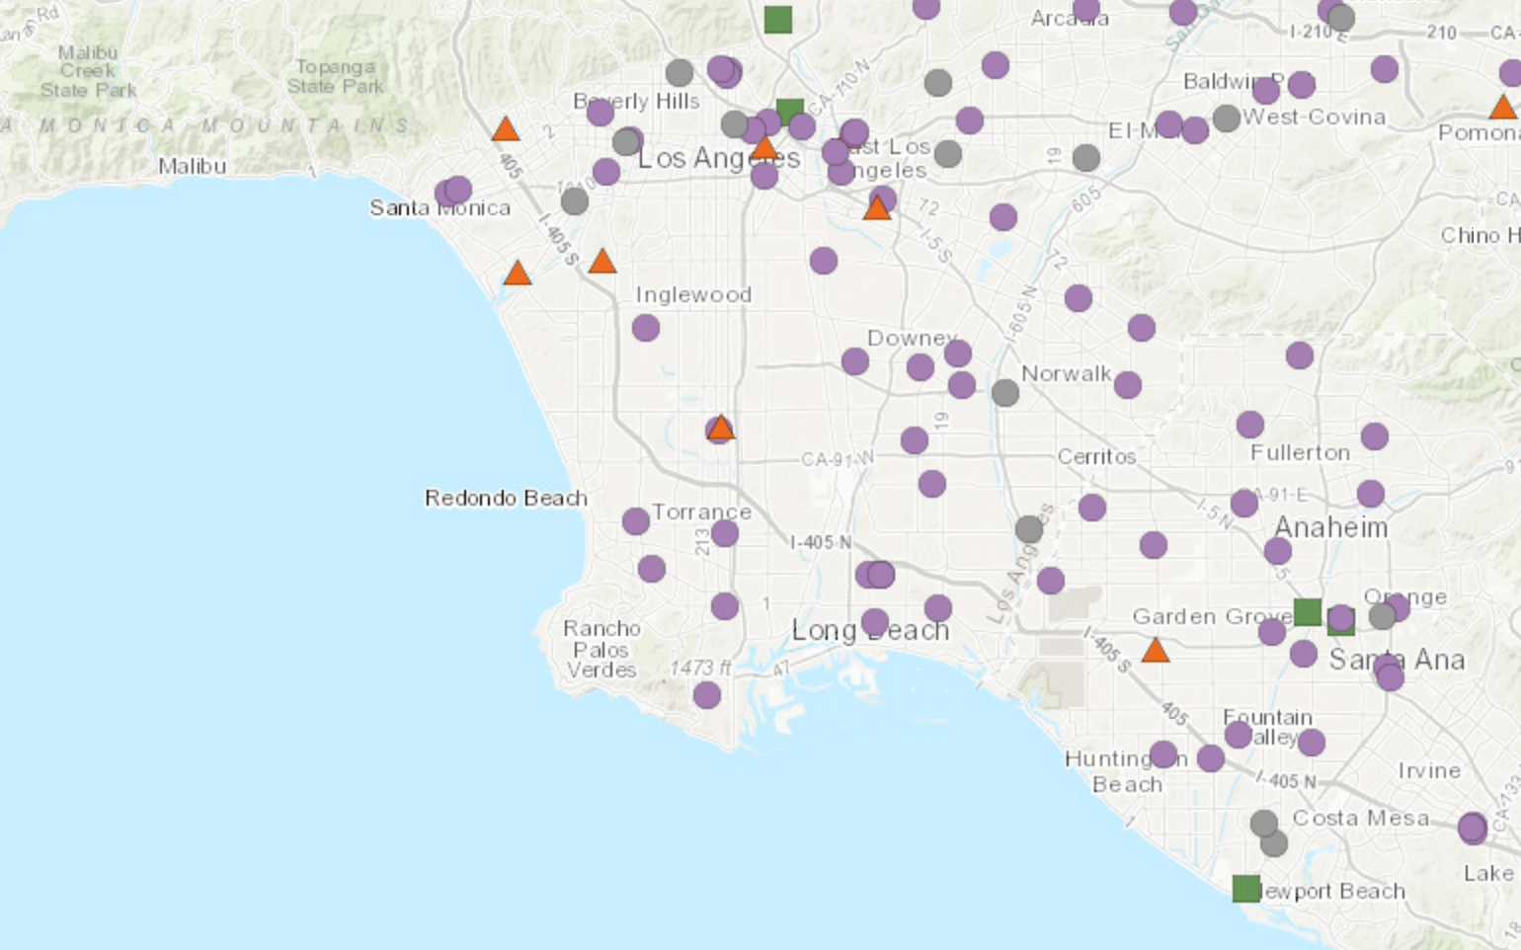
HOSPITAL INSPECTIONS
California hospitals’ MRSA infection rates, 2015. Orange is above the state average, green is below.

Slide 6
How The industry of health works
Code V91.07XA, which involves a "burn due to water-skis on fire” is another mystery she ponders: “Is it work-related?” she asks. “Is it a trick skier jumping through hoops of fire? How does it happen?”

Slide 7
Rural Hospital Care

Slide 8
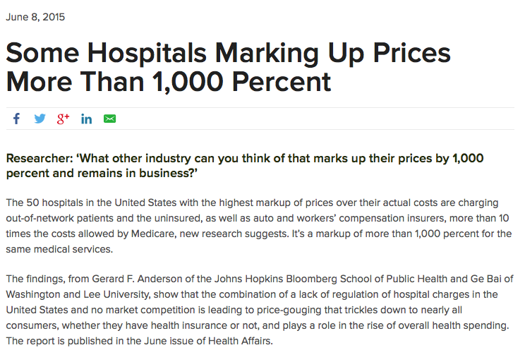
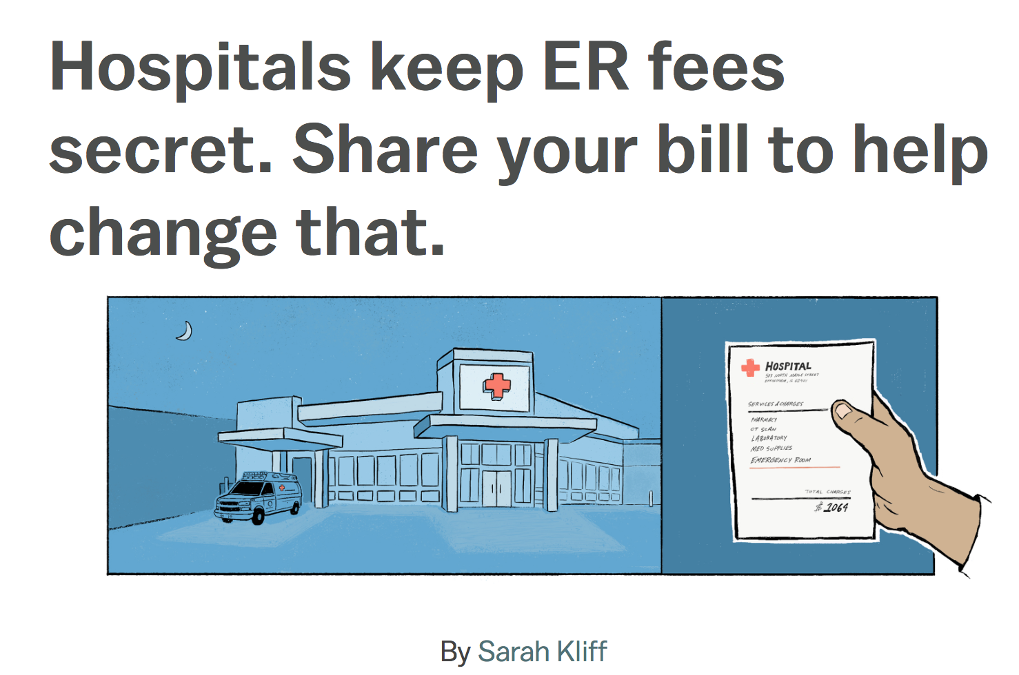
Hospital Charge Data

Slide 9
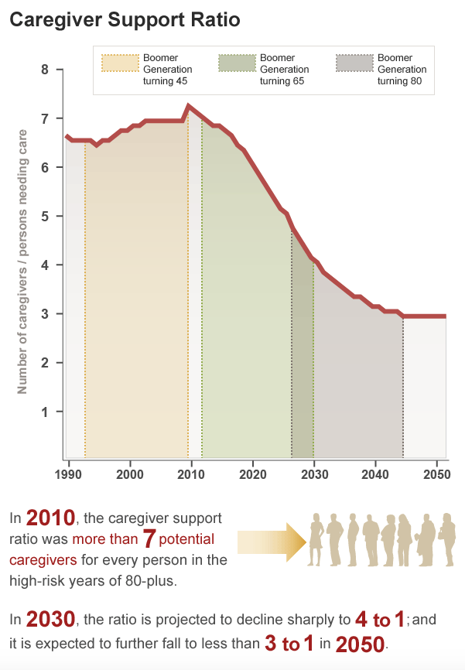
CAREGIVING

Slide 10
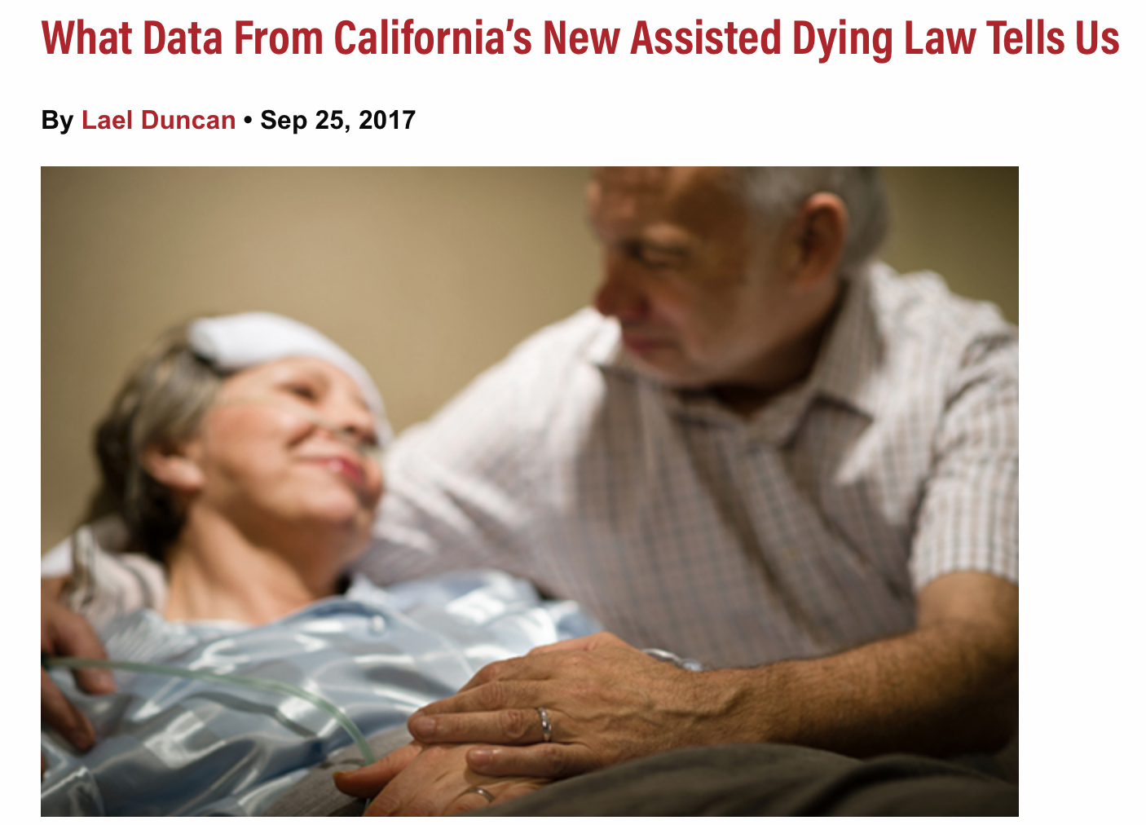
Physician-assisted Suicide

Slide 11
Abortion access

Slide 12
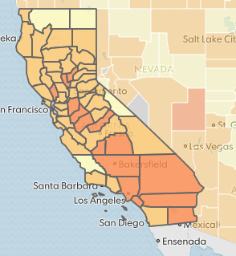
Chronic Conditions

Slide 13
NURSING HOMES

Slide 14
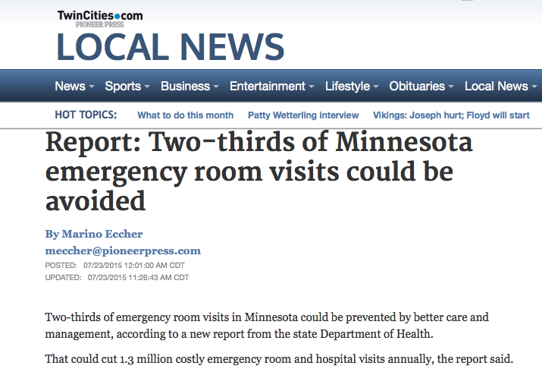
WHO’s coming in to your hospital?

Slide 15
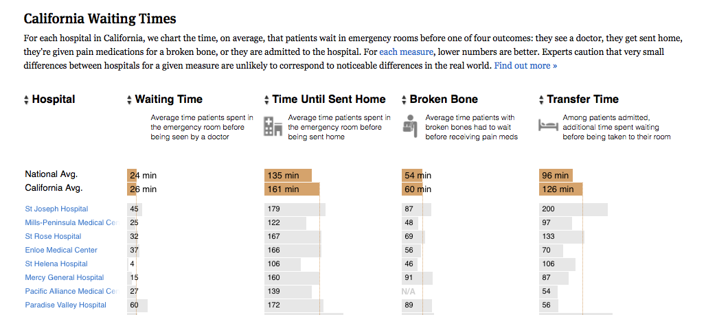
How Effective is your hospital?

Slide 16
HOW PEOPLE GET HURT

Slide 17
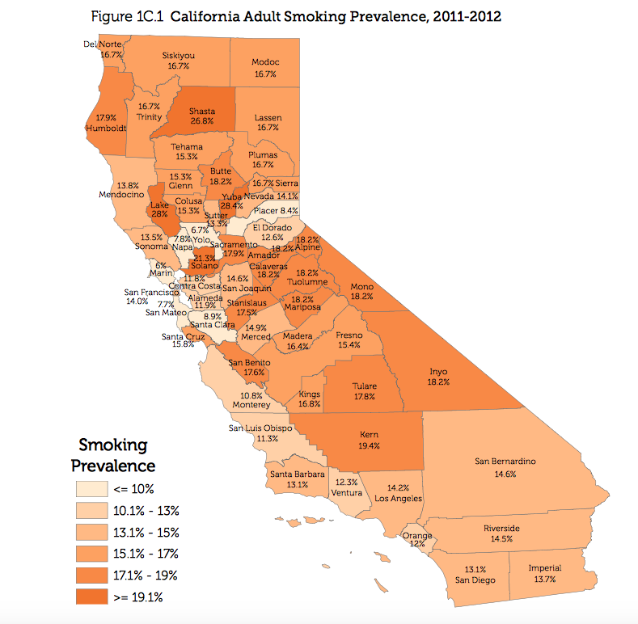
DRUG and Tobacco Use

Slide 18
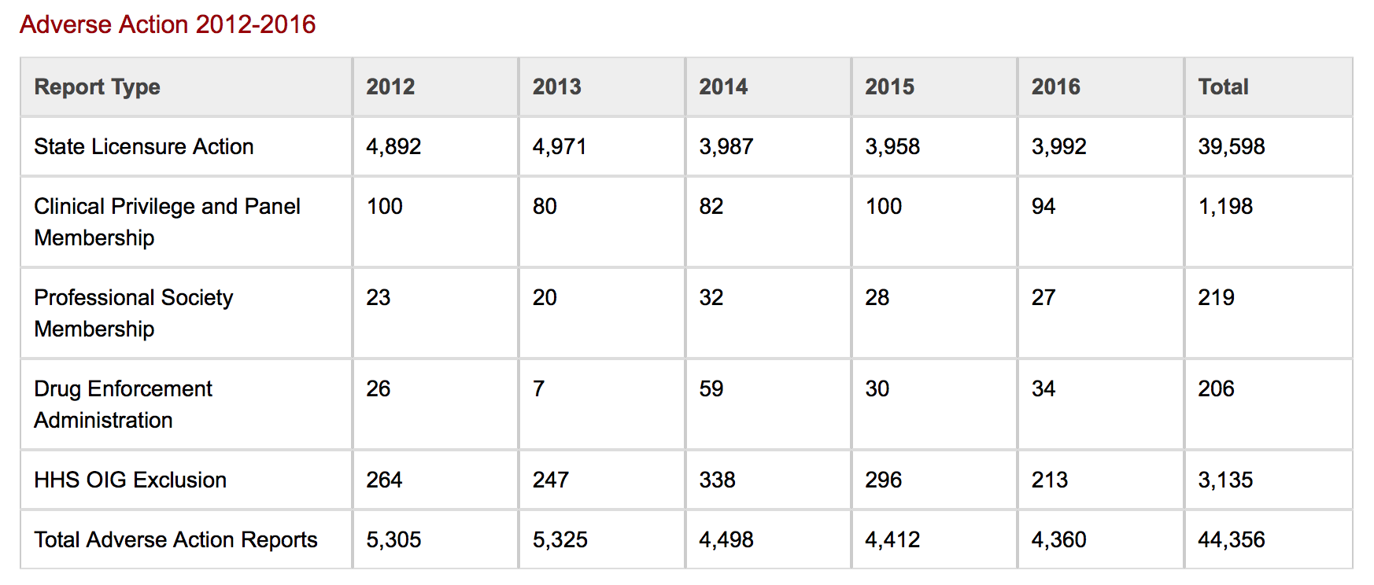
BAD Apples

Slide 19
Adverse Events
The FDA tracks adverse drug and medical device reactions. The data for both is public.

Slide 20
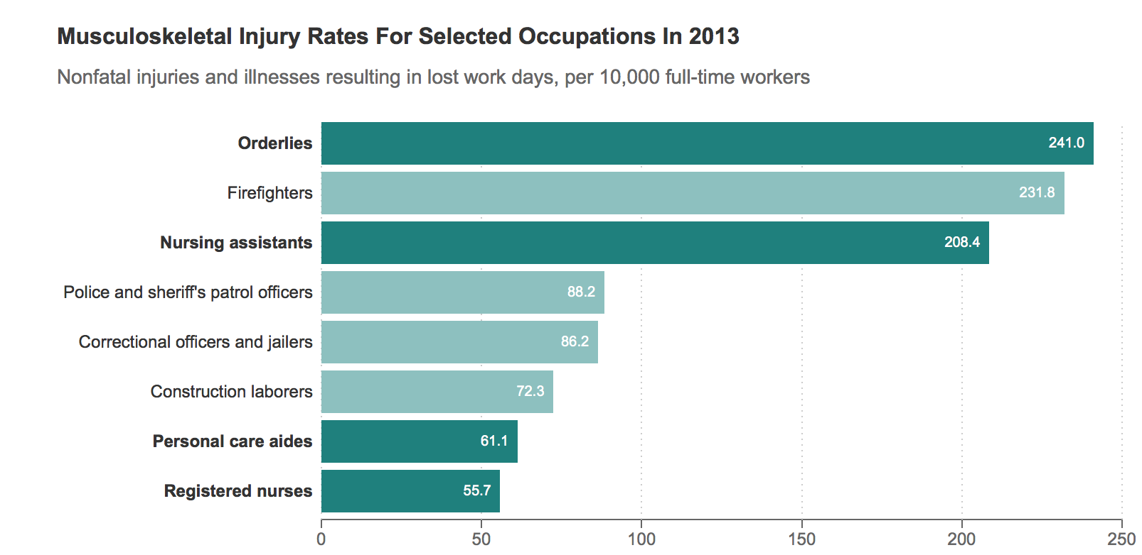
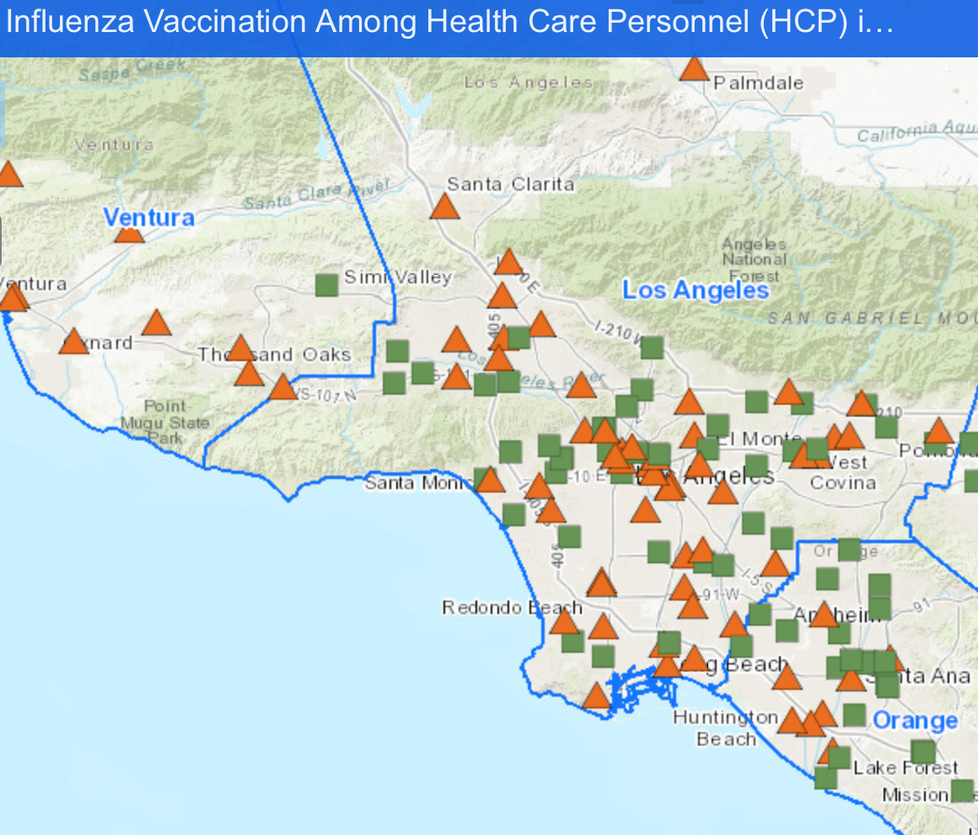
Health care employee Issues

Slide 21
Dental care

Slide 22
Hospice Care
More and more people are using hospice. There’s data on inspections, utilization, payments to hospice organizations

Slide 23
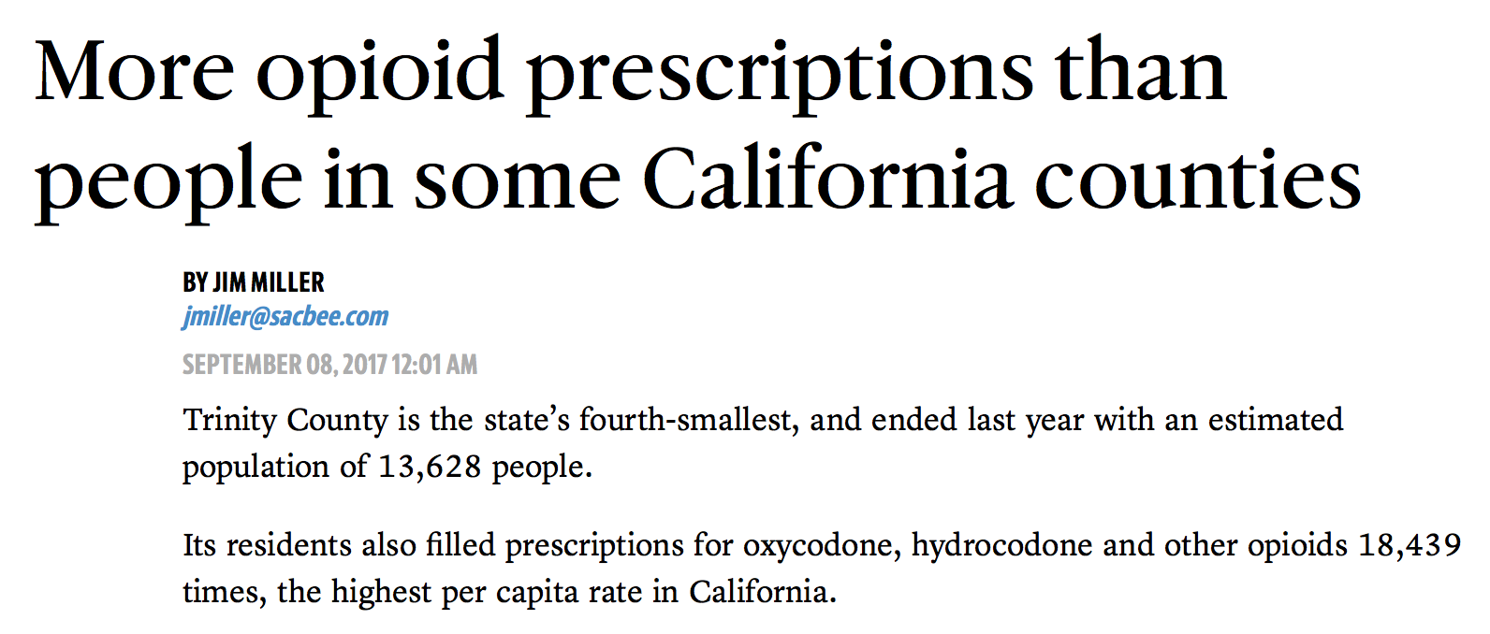
Opioids

Slide 24
Contact me
Meghan Hoyer
Data Editor, The Associated Press
202.641.9458
mhoyer@ap.org
Data.world signup: datateam@ap.org
Subject line: Data Distribution signup
Send: your name, news organization, work email

